Slide 1
Transforming steering controls to self driving
Object Detection
Instruction Manual
Hongshuo Wang
(hkw5146@psu.edu)
Professor. Siu Ling Leung
Notes:
Hi this Hongshuo Wang. I’m person who in charge of object detection in self driving project. First, I would like to say thank you professor Leung offer me this great opportunity; Moreover, thank s my partners Kavan, Tommy, and Owen. Without their great jobs, our project could be done successfully.

Slide 2
Summary:
Goal
Set up and Instructions
Process
Particular Progress
ssd mobilenetv2
Yolov4 tiny 416
Wireless control

Slide 3
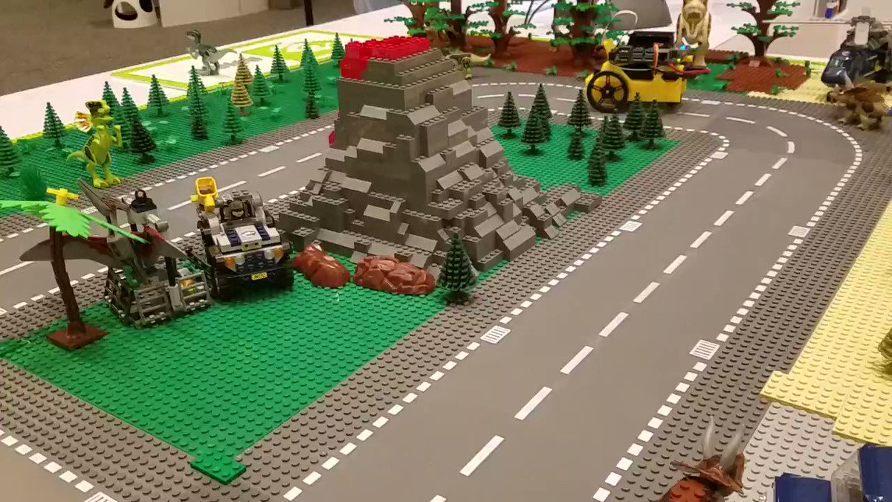
Project’s Goal
Our project goal is Transforming steering controls to self driving. We want using a extra steering wheel controller to drive our jetbot in a mini town and perform specific task when encounter a traffic signs. For example, when you see a stop sign, your car must stop a while or For no left turn sign, you car can only go straight forward or turn right etc.
When the jetbot see multiple signs at the same time, detecting the traffic signs at the same time. (Engineering-friendly zero coding)

Slide 4
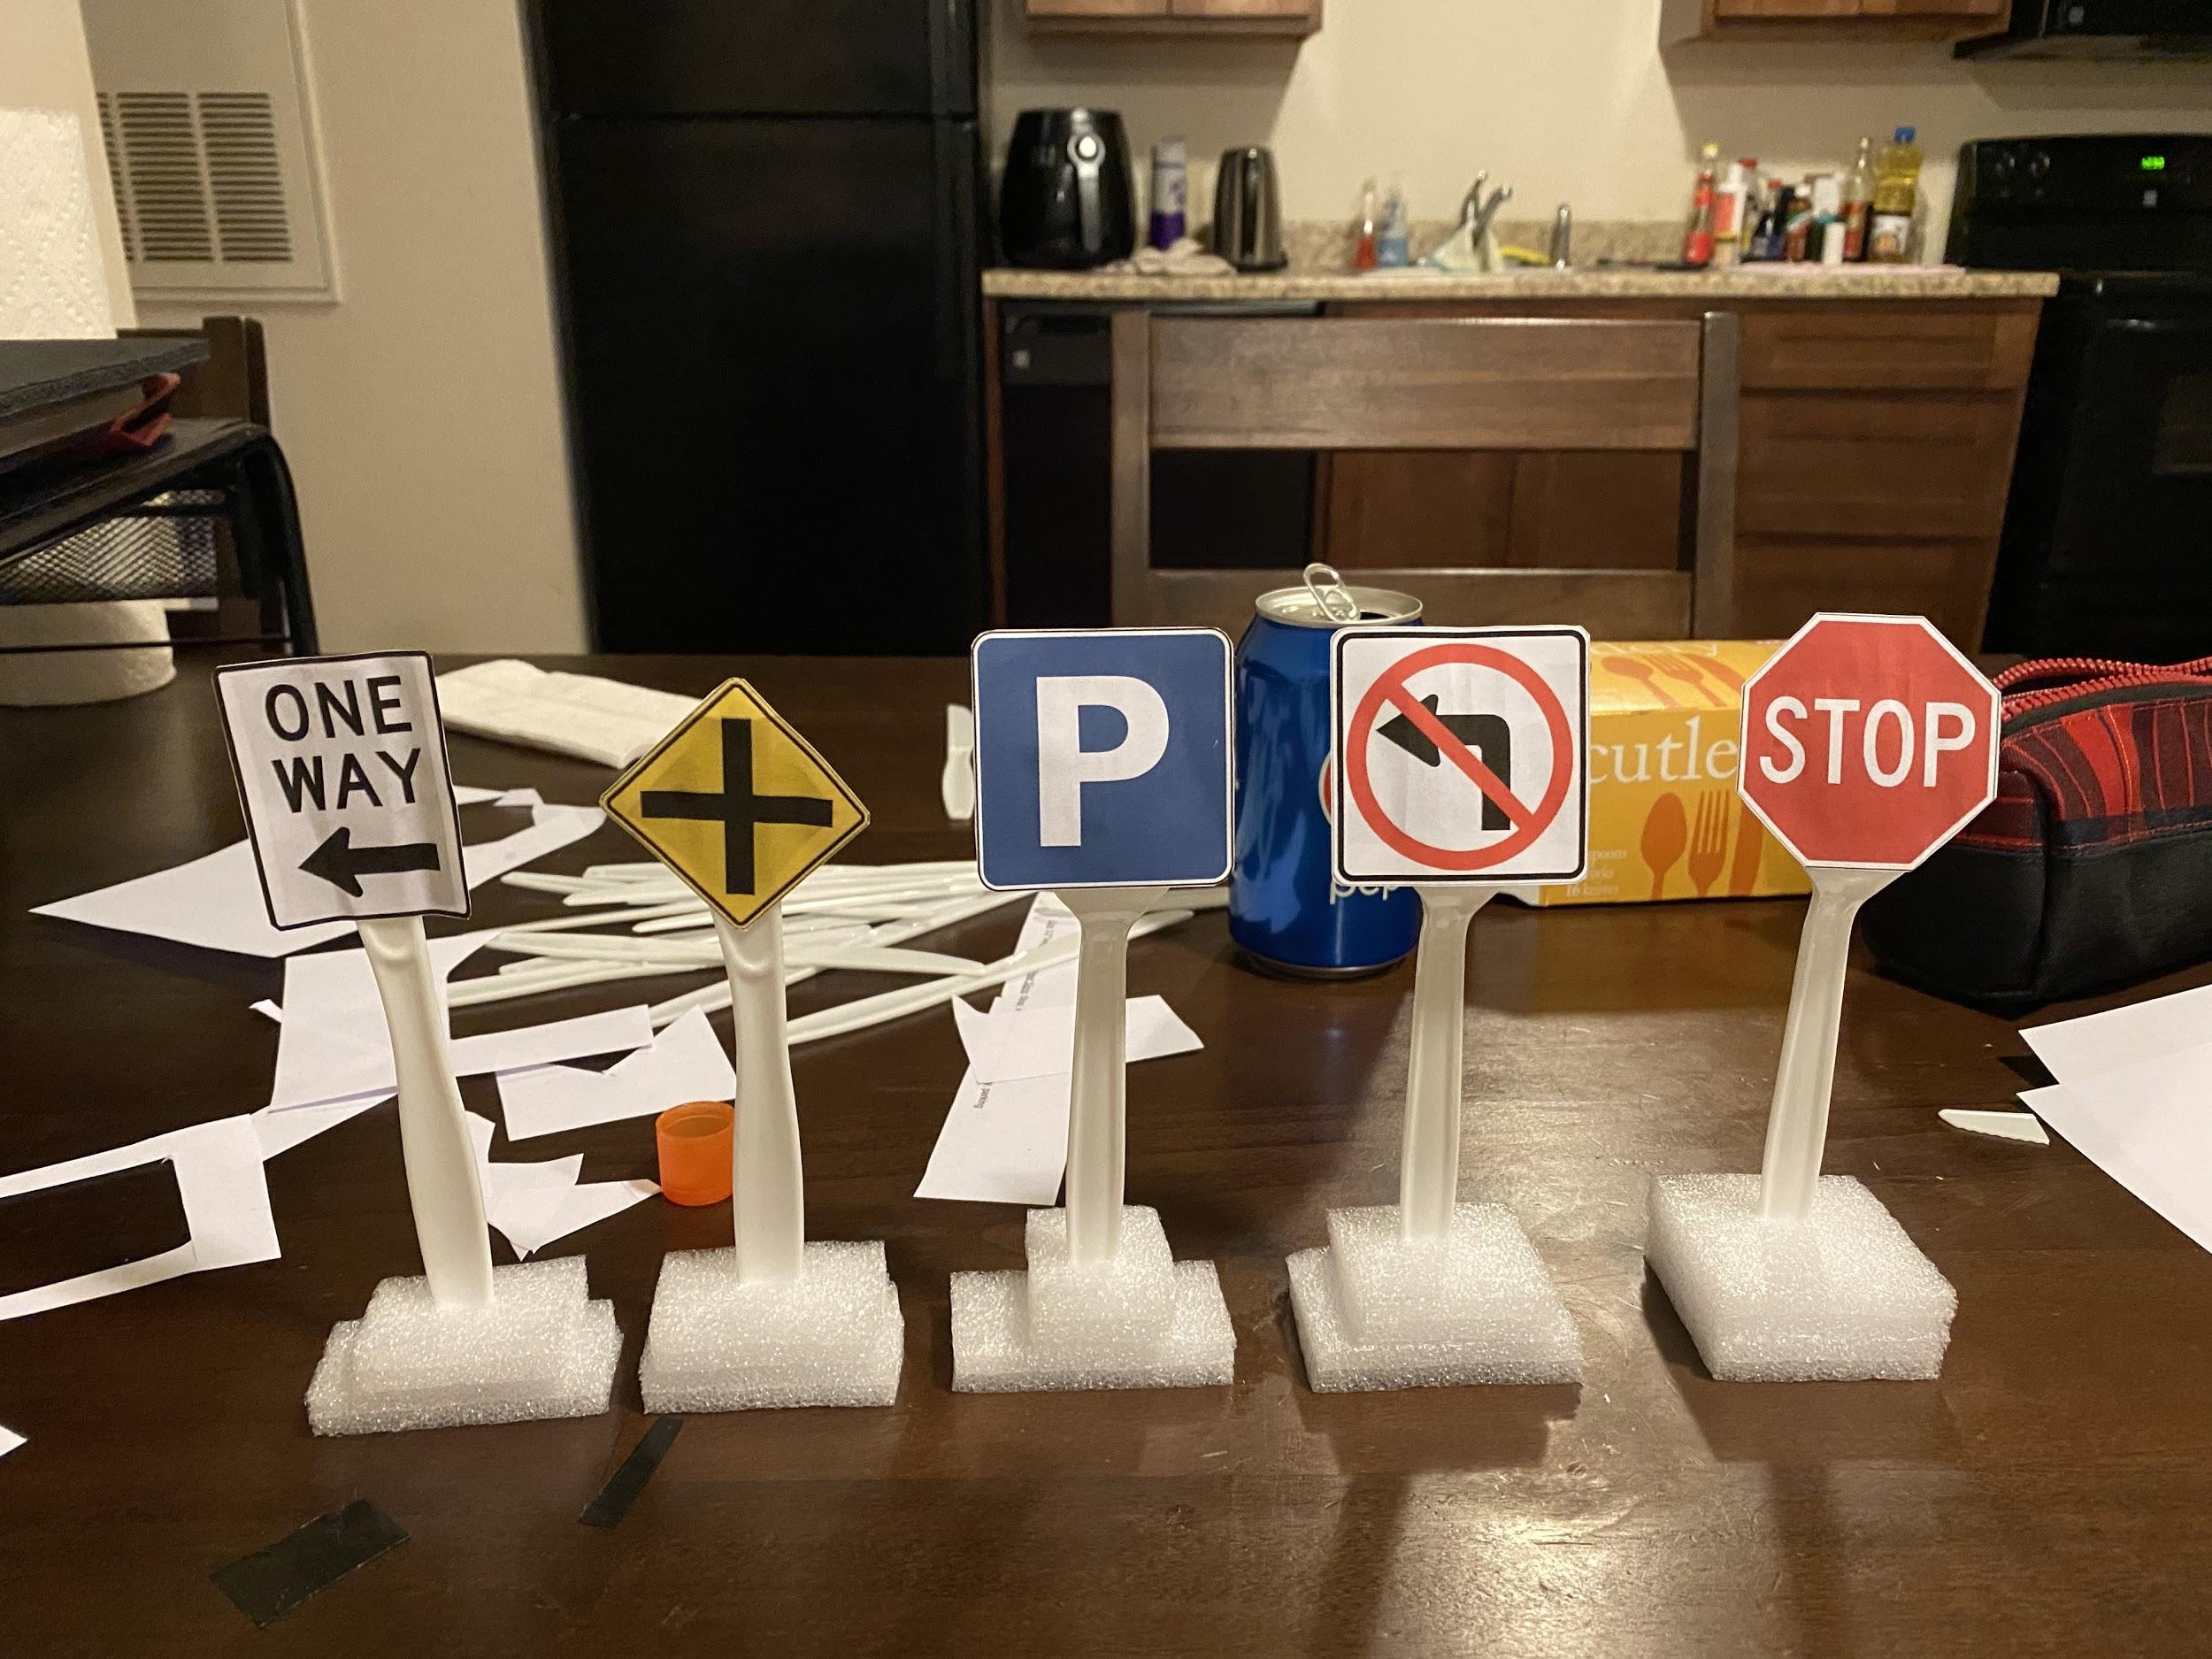
Object Detection Model on jetson nano
Five traffic signs: stop, insterection, no_left_turn, parking and one way.
Using transfer learning to detect five traffic signs on Jetbot.
Below link is source images https://docs.google.com/document/d/1Jq9aE4flSdQxKx9lJPnDWctRR3kcz9WCzpDbJDQIonY/edit?usp=sharing
I will send my small signs with the jetbot. Free to check the size of traffic signs.

Slide 5
Jetbot Set up
Complete Jetson Nano online course (including Jeson Nano OS System set up)
https://courses.nvidia.com/courses/course-v1:DLI+C-RX-02+V1/about
JetPack-4.3 for Jetson Nano
OpenCV-4.1.1
TensorRT 6
Jetbot is highly sensitive on the module version. Do not change the version of modules otherwise it will course the runtime error.
Particularly, TensorRT 6 (the compiling tool to speed up performing speed)
It takes particular trained weight(Tensorflow .pb, Darknet weight and cfg) as an input and output an engine file.
I personally do not recommend to run the model directly on the Jetson Nano due to the affordable latency.

Slide 6
Jetbot Set up (Please go through the default examples that the author provided first then do the modifications on the code)
2. Install the required package:
Download tensorrt demos github packages on the Jetson Nano
Recommend to connect a local screen, mouse and keyboard to do the setup instead of using Jupyter lab
https://github.com/jkjung-avt/tensorrt_demos
This is a project that includes image classification, facial detection and different version of object detection visualization and engine file’s transformation.
Please follow the steps in Readme file on this github version
And go through each command in link: https://jkjung-avt.github.io/jetpack-4.3/
Notice: I did some modifications on this project code and I will talk about that in the next slides

Slide 7
Mode: Yolov4-tiny-416 vs SSDmobilenetv2
Both modes has desired performance on Jetson Nano
You can check out the performance on my YouTube video:
https://youtu.be/VCOE-HqE7u8
Next few slides are the modification that I made in order to run my trained model on the Jetson Nano.

Slide 8
Modification on Tensorrt_demos(SSDmobilenetv2)
trt_ssd.py
In utils dir
ssd_classes.py
In ssd dir
build_engine.py

Slide 9
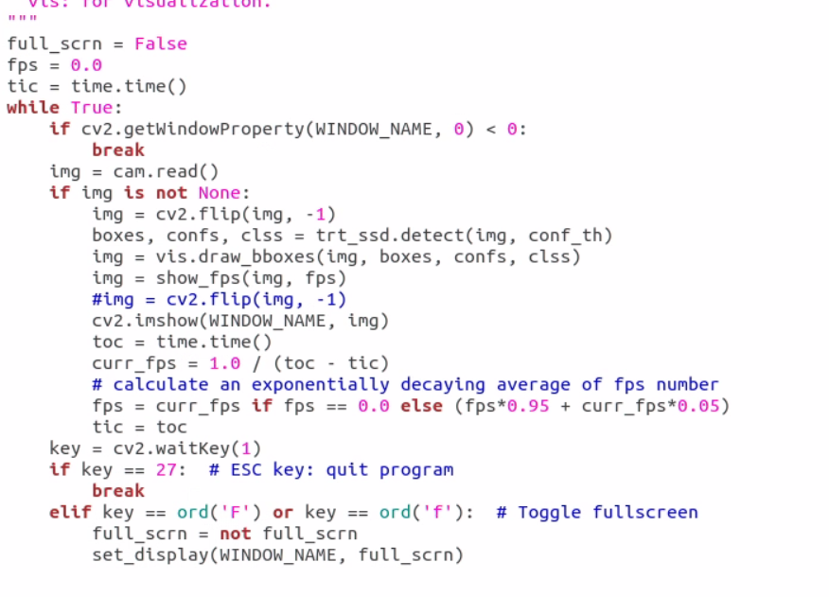
trt_ssd.py
This file will run the built engine file
and visualize the bounding box
I add a line code to flip the camera windows:
Img = cv2.flip(img, -1)

Slide 10
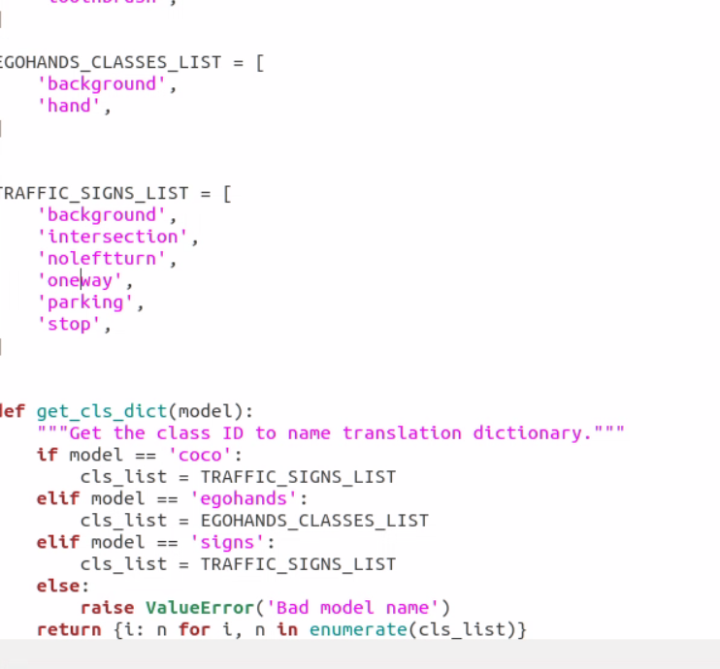
ssd_classes.py
This file stores the class names. I add a list called TRAFFIC_SIGNS_LIST including six class names (5 traffic signs plus a background)
If you want to use your own built-in classes, free to create a list and add all your class name + ‘background’ then change the cls_list = ‘your list name’ in the function get_cls_dict below:
if model == ‘coco’:

Slide 11
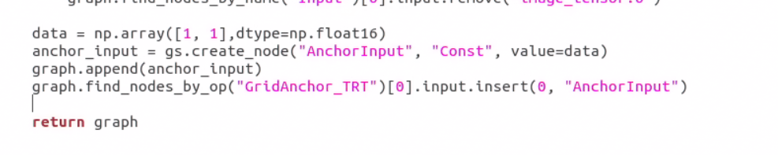
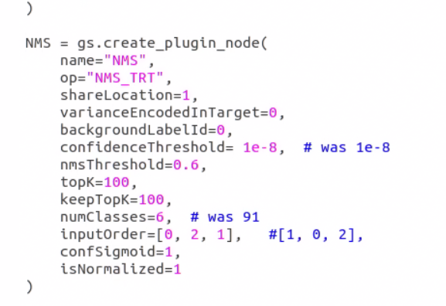
build_engine.py
This file transform weight file (*pb) into engine file
I change the number of classes in NMS (5 traffic signs + background)
Furthermore, I add the four lines of code after the final return. (Please use the tensorflow 1.15.2 version to train your model) Cannot make sure that the code is working on the other version.
(Verified on Tensorflow 1.15.2 version)

Slide 12
Modification on Tensorrt_demos(Yolov4-tiny-416)
trt_yolo.py
In utils dir
yolo_classes.py

Slide 13
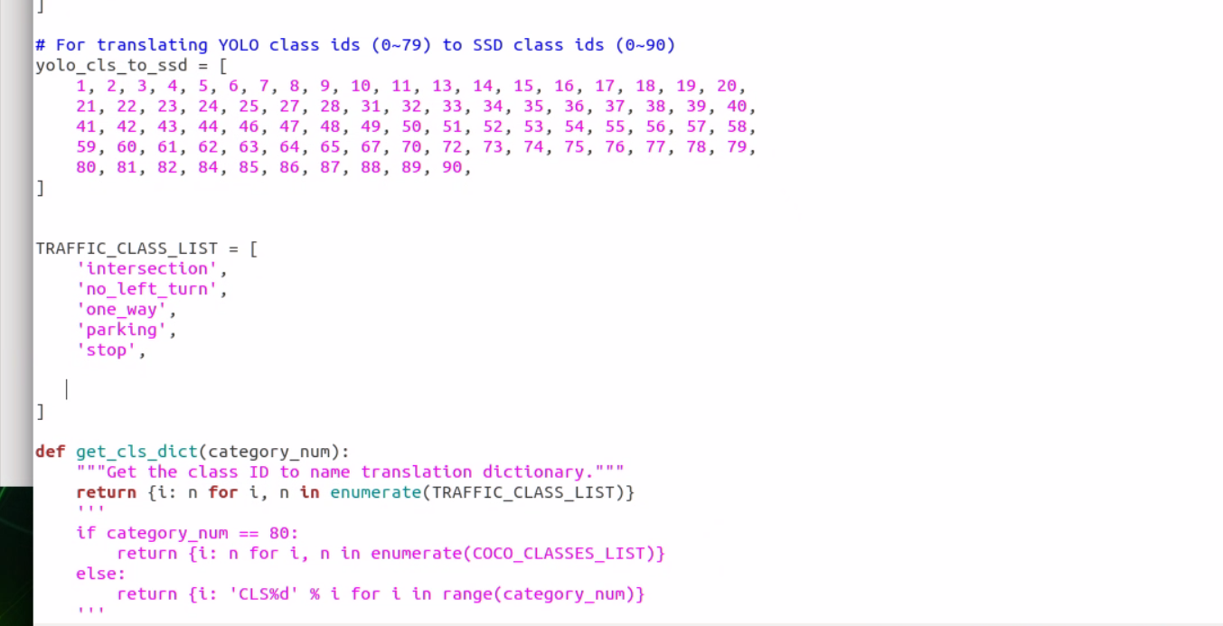
yolo_classes.py
This file stores the class names. I add a list called TRAFFIC_CLSSS_LIST including fix class names (5 traffic signs)
If you want to use your own built-in classes, free to create a list and add all your class names then copy the code besides. (Replace my list name with yours)

Slide 14
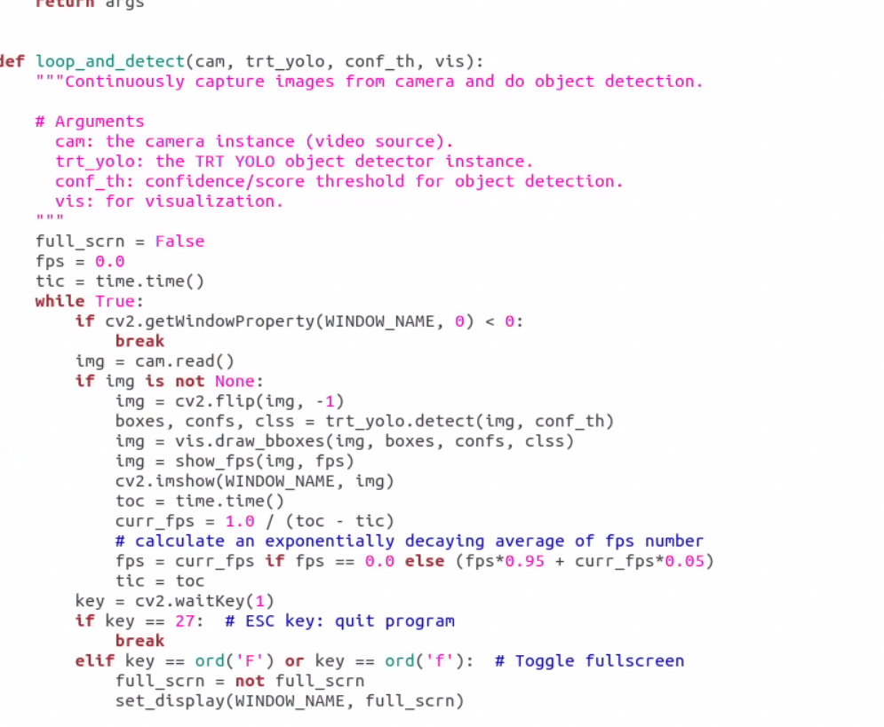
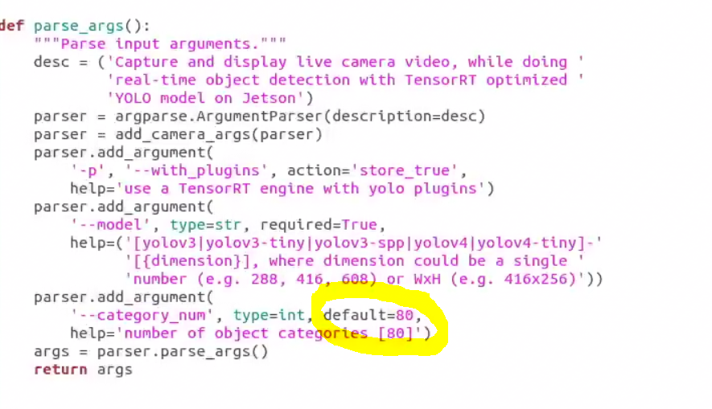
trt_yolo.py
This file will run the built engine file
and visualize the bounding box
I add a line code to flip the camera windows:
Img = cv2.flip(img, -1)
Change the default number to the number of your list(my list includes 5 signs => default=5)

Slide 15
Procress:
Collecting data: Creating a dataset for five traffic signs
Label the images
Data augment
Selecting suitable model
Training the model
Evaluating the trained model on Jeson Nano
Improving the model

Slide 16
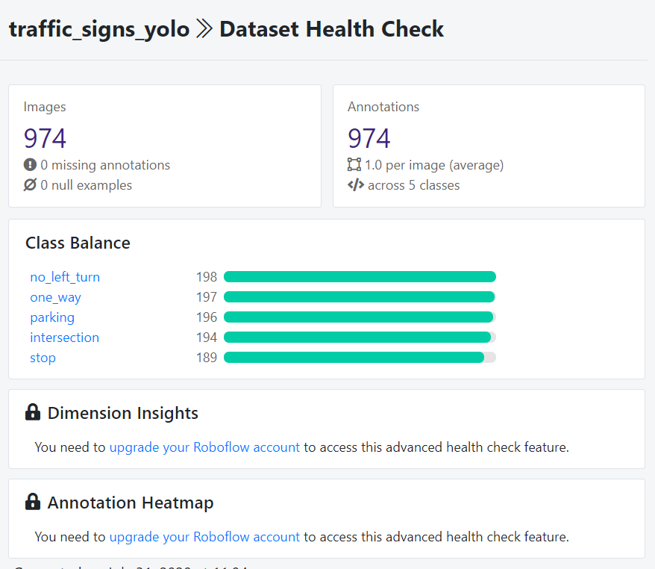
Collecting Data
Collect 974 in total 224 x 224 raw image by using jetbot camera
Below link are source images
https://drive.google.com/file/d/1QVxLXl9VznPFaaA0m6bTjNtkJx_Yc6mv/view?usp=sharing
Notes:
Then I import my labeled image(both jpg file and xml file) to roboflow program which will can do data augmentation and transfer your data into specific version satisfy different model needs. I did rotation, cropping and shearing on our input images and Finally enlarge our dataset to 2355 image in order to get a more robust model.

Slide 17
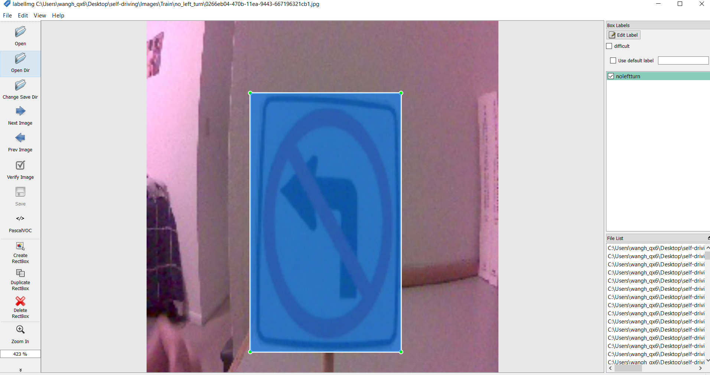
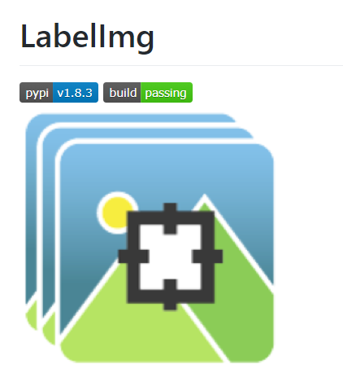
Label the image
Downloads Labellmg
https://github.com/tzutalin/labelImg
Label the images (please check the github ReadMe file)

Slide 18
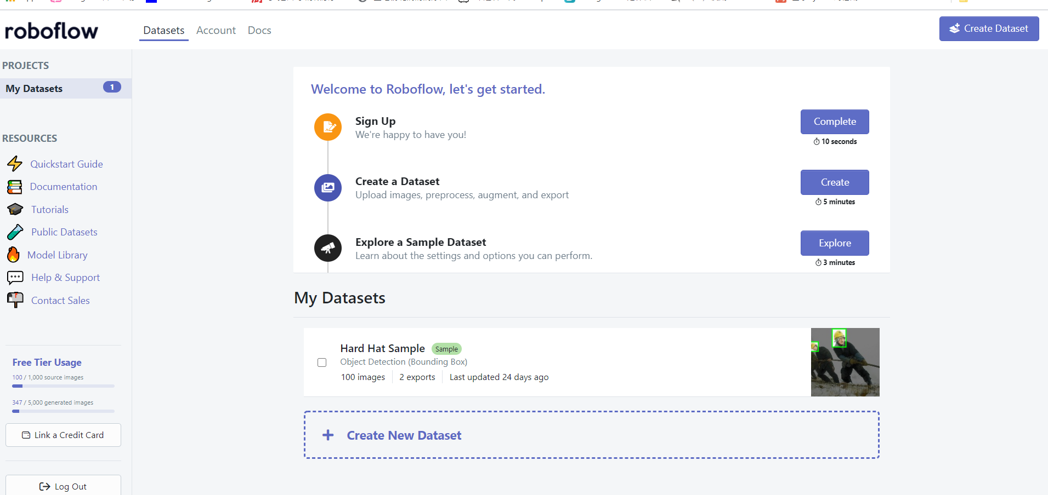
Data Augmentation
Create a roboflow account and update the label files(xml) and source images to the website
https://app.roboflow.com/
Roboflow can automatically do data augmentation and transform to desired format version for your
Please see the website guide tour

Slide 19
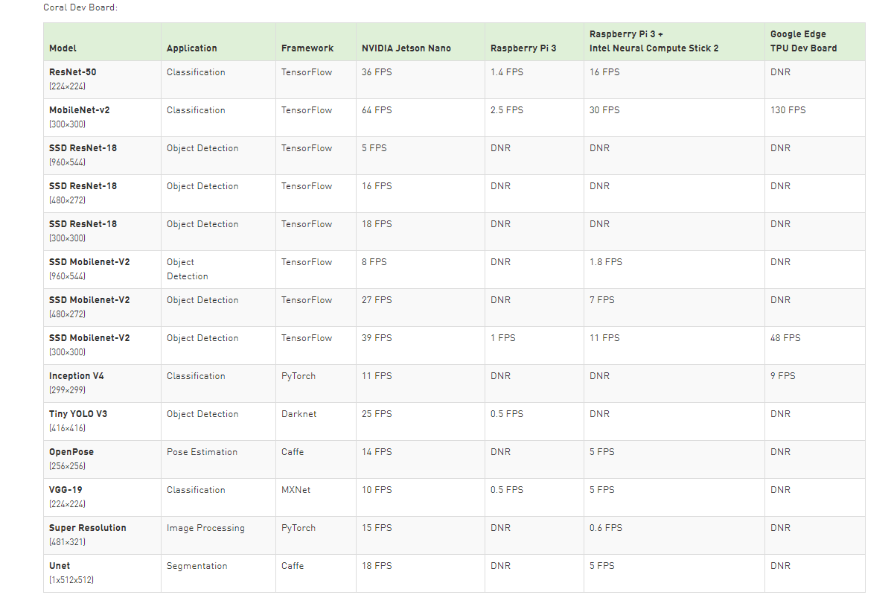
Selecting suitable model
Yolov3 vs SSDmobilev2 vs Yolov4
Notes:
Next, I need to decide which kinds of model. By doing researches and looking at the official Nvidia website, I pick three potential options: yolov3, ssdmobilev2 and yolov4. All of them are current popular model on mobile object detection.

Slide 20
Training our model
You can download tensorflow or pytorch or Darknet then train everything on your computer
https://jkjung-avt.github.io/hand-detection-tutorial/
Or you can train on the colab (What I did on jetson Nano)
Below is the link that you can train your model using colab
Please follow the introduction of each model in colab
https://models.roboflow.com/

Slide 21
Training the model (result)
Using colab (roboflow ai)
ssdmobilev2 (tensorflow 12 hours)
Yolov3 darknet 6 hours
Yolov4 darknet 8 hours vs Yolov4-tiny-416 5 hours
Notes:
It almost took me three weeks to prepare the data , build the environment, train three model and finu tune it. I was firstly thinking to train the model on the jetbot but when I tested on jetbot, it runs extremely slow since jetbot got only 4 memory and limited gpu. In order to save time, I make most of colab by create several google accounts and trains all models on colab at the same time. These time I listed in the slides is the average time of took to train each model

Slide 22
Evaluating the trained model on Jeson Nano
Set up the environment:
tensorflow 1.15.2 object detection API
Pycuda
onnx == 1.14
Visualization:
github tensorrt_demos
Callback:
Yolov4 > yolov3 > ssdmobile
FPS:
SSdmobilev2 (about 15 FPS) > yolov4 tiny (10 FPS) > yolov4 (4 FPS) > yolov3 (2 FPS)
Notes:
Last, I want to combine my last two topics together. The biggest problem I faced after I trained each model and evulated on the jetbot is running speed. Because of the jetbot limited performance as I mentioned before, the model runs unafford slow at low FPS. When I look at the official guides of jetson nano, it suggests to compile our trained model into the engine file which speeds up the performance of the model on jetbot. Depending on the github module tensorrt_demos, I successfully build up the engine file, and compare the results’ parameter. I make some trade off between callbacks rate and FPS. And finally, I decide to pick yolov4 tiny model as my final model. You can see how well it performs in the demos slide. Thank for your watching.

Slide 23
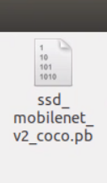
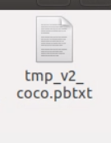
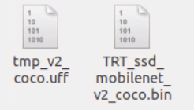
Progress(output ssd engine file)
After setting up all the packages, you should test given default model first then try your models. Make sure you go through all the default model without any error.
Do the modification on the code(see previous slides)
Update your trained weight file (for example frozen_graph.pb) below the SSD directory
Rename your file into ssd_mobilenet_v2_coco then
Go to dir ssd then
Type command:
Ignore the warning, if everything is fine it will output
Three files (bin file == engine file)

Slide 24
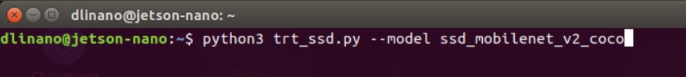
Visualizing the model
5. Go back to tensorrt_demos dir
6. type command:

Slide 25
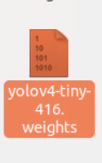
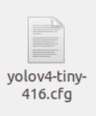
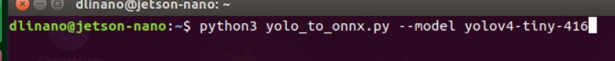
Progress(output yolov4-tiny-416 engine file)
After setting up all the packages, you should test given default model first then try your models. Make sure you go through all the default model without any error.
Do the modification on the code(see previous slides)
Update your trained weight file (for example cfg and weights files) below the yolo directory
Rename your file into yolov4-tiny-416.cfg and yolov4-tiny-416.weights then
Go to dir yolo then
Type command:
It will output onnx file

Slide 26
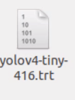
Output yolov4-tiny-416 engine file
5. Type command (transform onnx file to engine (bin) file:
The final output will be:

Slide 27
Visualizing the model
5. Go back to tensorrt_demos dir
6. type command:
7. There exists an improved version of yolo-tiny-version (please check on the project github) https://github.com/jkjung-avt/tensorrt_demos
Then you need to type command:

Slide 28
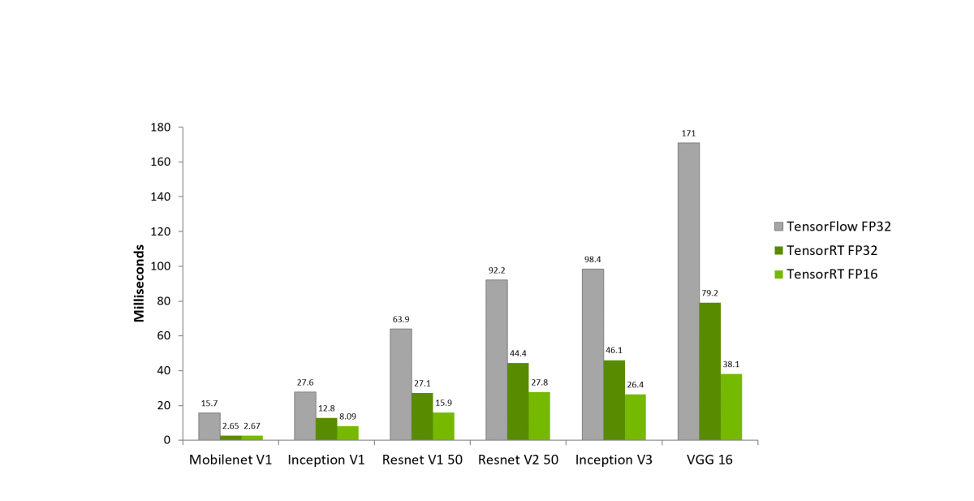
Improving the model
Transfer weight file to Nvidia engine file to speed up the speed
Install tensorrt 6.1
Create 8 GB swipe file in order to expand jetbot’s memory

Slide 29
Demos
https://www.youtube.com/watch?v=VCOE-HqE7u8&t=93s
Notes:
Thank for your watching

Slide 30
Wireless Control(remote desk)
Browse https://forums.developer.nvidia.com/t/remote-access-to-jetson-nano/74142/10
Downloads NoMachine RAMV8
https://www.nomachine.com/download/linux&id=30&s=ARM
Install both programs on the jetson nano and your local computer
Then follow the instruction: https://www.nomachine.com/getting-started-with-nomachine
Make sure that your local computer and jetson Nano are in the same LAN or connected to the same wifi

Slide 31
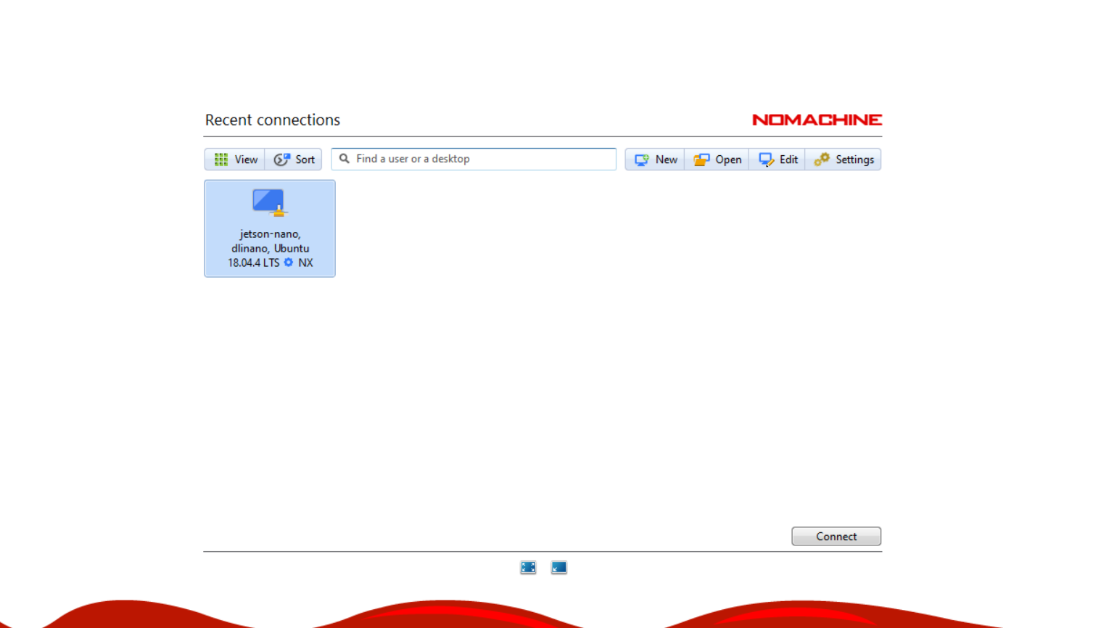
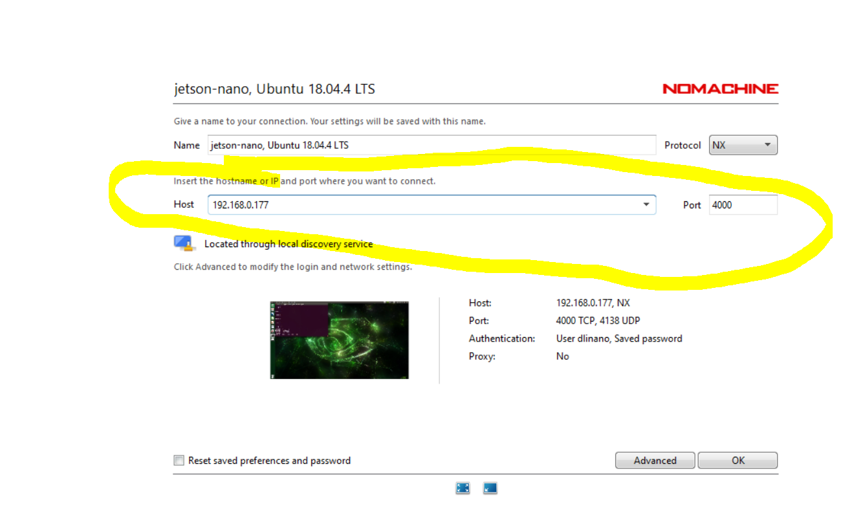
Using No Machine
Click the browse the connect bar in the no machine app
Click connect bottom
You may need to edit the connect
Just replace the ip address that display on your jetbot

Slide 32
Reference
https://developer.nvidia.com/embedded/jetson-nano-dl-inference-benchmarks
https://app.roboflow.ai/dataset/traffic_signs_yolo/8
https://github.com/tzutalin/labelImg
https://github.com/jkjung-avt/tensorrt_demos
https://courses.nvidia.com/courses/course-v1:DLI+C-RX-02+V1/about
https://models.roboflow.ai/
https://github.com/jkjung-avt/tensorrt_demos/blob/master/ssd/build_engine.py
https://www.minds.ai/post/deploying-ssd-mobilenet-v2-on-the-nvidia-jetson-and-nano-platforms
https://blog.csdn.net/weixin_43046653/article/details/101106542?ops_request_misc=%257B%2522request%255Fid%2522%253A%2522159471945319195239845897%2522%252C%2522scm%2522%253A%252220140713.130102334.pc%255Fall.%2522%257D&request_id=159471945319195239845897&biz_id=0&utm_medium=distribute.pc_search_result.none-task-blog-2~all~first_rank_ecpm_v3~pc_rank_v3-2-101106542.pc_ecpm_v3_pc_rank_v3&utm_term=jetbot+nano+%E7%89%A9%E4%BD%93%E8%AF%86%E5%88%AB

Slide 33
Reference
https://github.com/AastaNV/TRT_object_detection
Object Detection with MobileNet-SSD slower than mentioned speed - Jetson & Embedded Systems / Jetson Nano - NVIDIA Developer Forums
dusty-nv/jetson-inference: Hello AI World guide to deploying deep-learning inference networks and deep vision primitives with TensorRT and NVIDIA Jetson.
How to Train YOLO v5 on a Custom Dataset - YouTube
[ASK] How to make tensor RT engine from frozen graph tensor flow? - Jetson & Embedded Systems / Jetson Nano - NVIDIA Developer Forums
Object Detection with MobileNet-SSD slower than mentioned speed - Jetson & Embedded Systems / Jetson Nano - NVIDIA Developer Forums

